Slide 1

Introduction
Book Barter
CSE-5324-002-SFWR ENG I ANLY, DSGN, TESTING
Iteration 1
Team Name: The Fivers | Team Number: 12 10/02/23
Team Members
Niharika Dandu
Varad Nair
Srujan Chinta
Kushwanth Sai Bollepalli
Sreelakshmi Mopuri

Slide 2
Agenda
Introduction
Project Description
Over All Design
Requirements
Use Case List
High Level Use Cases
Use Case Diagram
Requirements to Use Case Traceability Matrix (RUCTM)
Increment Matrix (IM)
Domain Model
Summary

Slide 3

Introduction

Slide 4
Project Description
Users register to establish a personalized reading identity, searching and browsing allows them to locate their next literary adventure
Messaging facilitates seamless communication and location services make in-person/local exchanges simple
Books Rating empowers readers to make informed choices, and safety & privacy features ensure secure interactions
Wishlist Management guarantees one will never miss a desired read
In short, "Book Barter" transforms book sharing into a hassle-free, enjoyable experience.

Slide 5
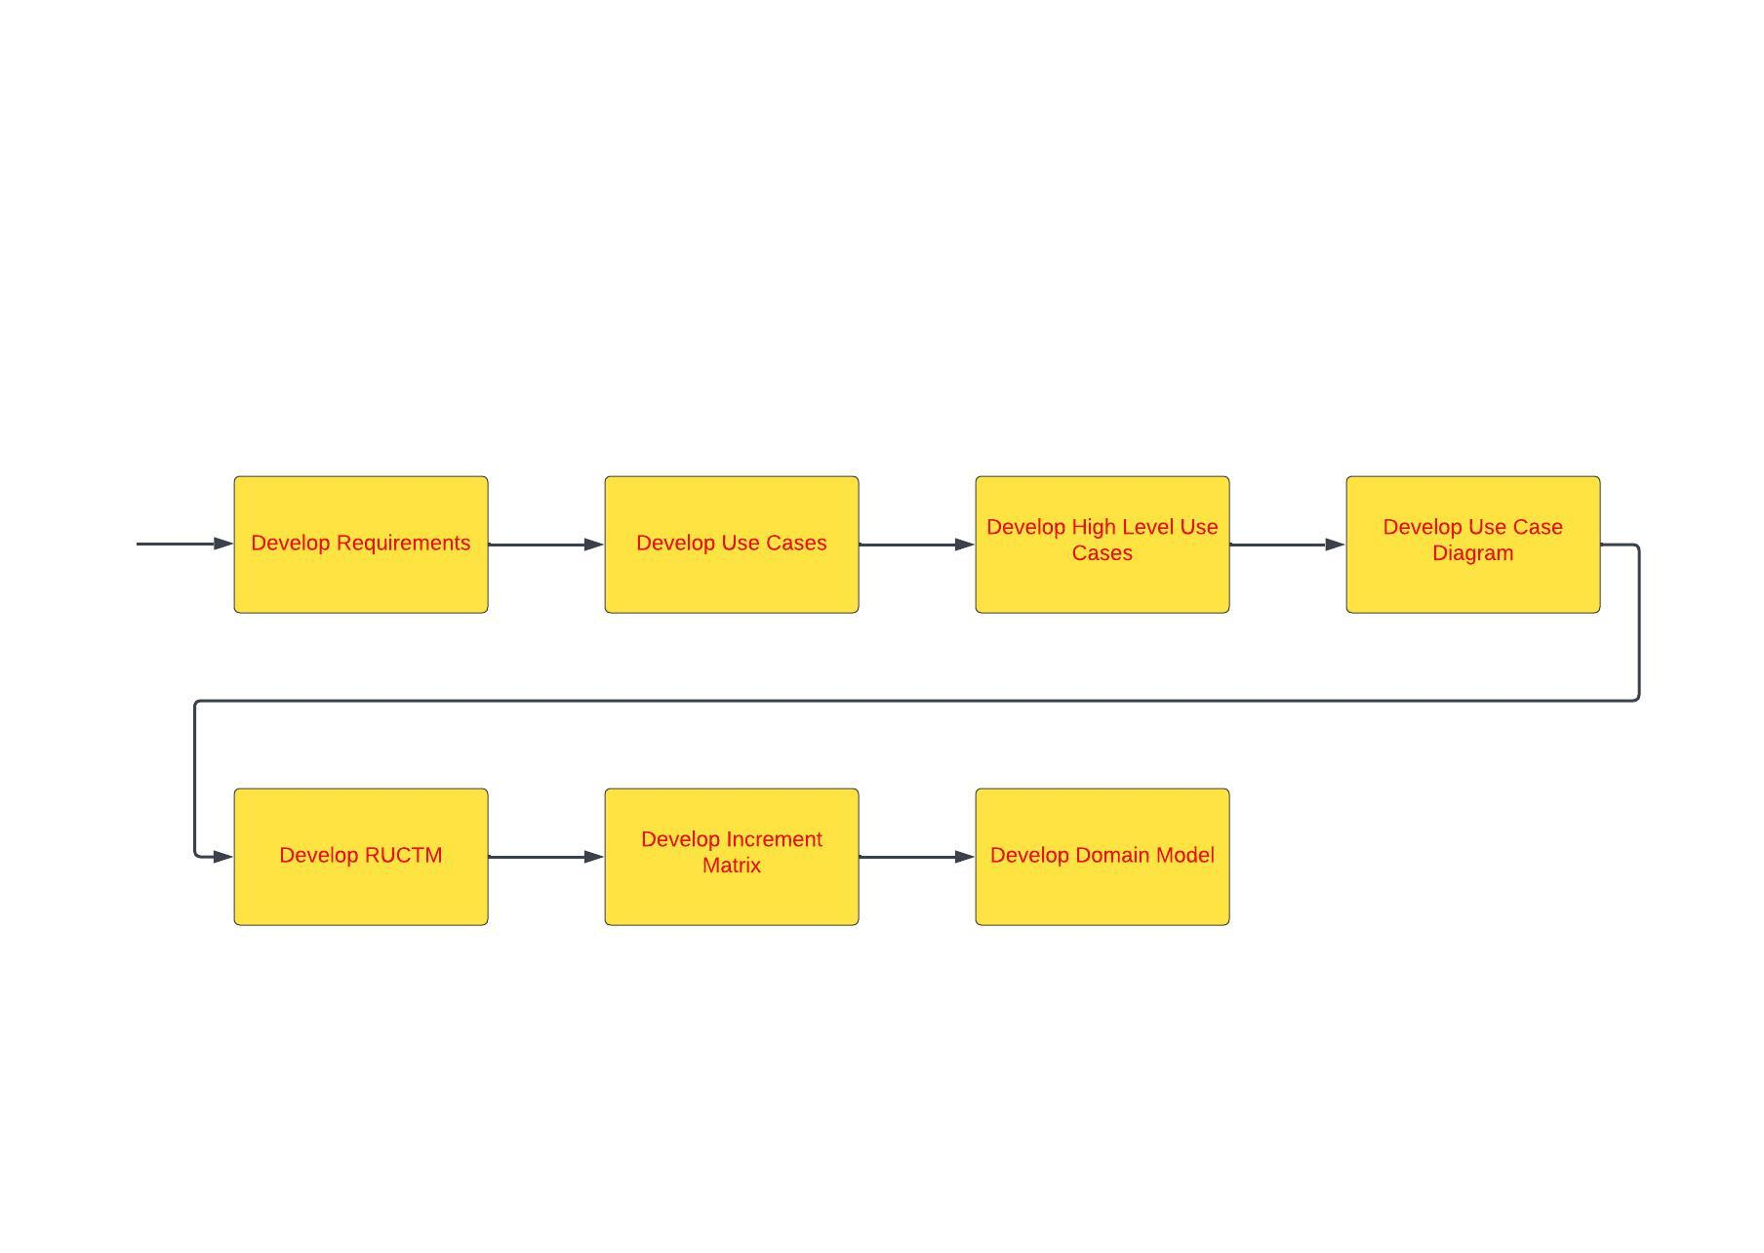
Over All Design Approach
Develop Sequence Diagram
Develop Design Class Diagram
Develop Sequence Diagram
Develop Sequence Diagram
Test And Deploy
Apply Design Pattern
Apply Design Pattern

Slide 6
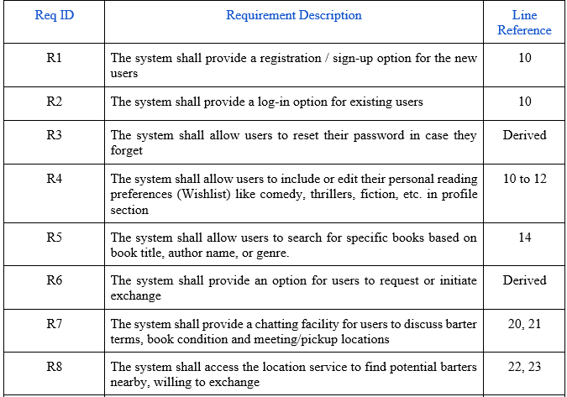
Requirements

Slide 7
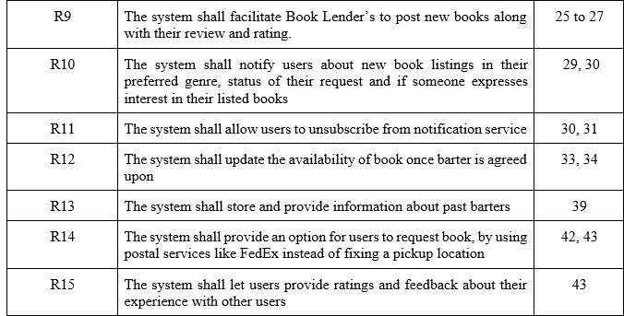
Requirements<<Continued>>

Slide 8
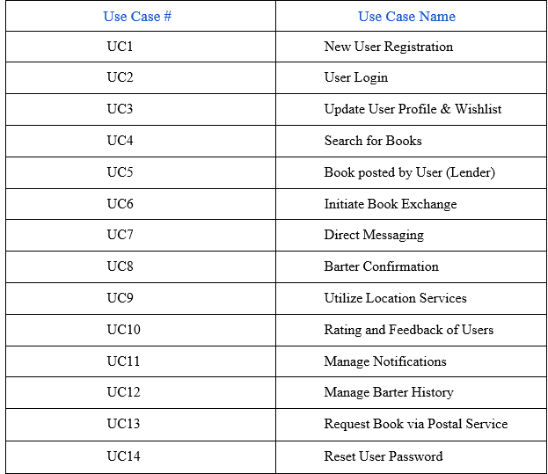
Use Case List

Slide 9
High level Use Cases
UC1: New User Registration
TUCBW the new users who can create an account by providing registration details and personal reading preferences
TUCEW the new user is registered
UC2: User Login
TUCBW the user clicking the login button and entering details given during registration
TUCEW user logging in successfully
UC3: Update User Profile & Wishlist
TUCBW users update their profile information and reading preferences (Wishlist)
TUCEW user profile & wishlist have been updated
UC4: Search for Books
TUCBW enabling users to search for specific book titles, authors, or genres
TUCEW list of books that match with the search keyword
UC5: Book posted by User (Lender)
TUCBW book lender fills out book name, book author, description, genre and rating along with the book cover picture and submits it
TUCEW book details will be made public along with the ratings

Slide 10
High level Use Cases<<Continued>>
UC 6: Initiate Book Exchange
TUCBW users express their interest in exchanging/receiving a book with another user by scrolling through their feed
TUCEW users decide according to their interest
UC7: Direct Messaging
TUCBW communication between users to discuss book conditions, barter terms, or arrange meetup/pickup details
TUCEW confirmation/denial of book exchange
UC8: Barter Confirmation
TUCBW users confirm the exchange/donation of books and update the status of the book (available or not), ensuring transparency
TUCEW barter confirmation
UC9: Utilize Location Services
TUCBW users can find potential barter nearby, reducing the need for long-distance exchanges
TUCEW finding book barter
UC 10: Rating and Feedback of Users
TUCBW users rate other genuine users with feedback after the book is delivered
TUCEW rating the users

Slide 11
High level Use Cases<<Continued>>
UC11: Manage Notifications
TUCBW users customize or control their notifications
TUCEW notifications being customized or turned on/off
UC12: Manage Barter History
TUCBW users keep track of past barters and view their history
TUCEW maintaining barter history
UC13: Request Book via Postal Service
TUCBW users requesting a book using postal services like FedEx
TUCEW book is being delivered
UC14: Reset User Password
TUCBW users can enter email for password reset
TUCEW password being updated

Slide 12
Use Case Diagram

Slide 13
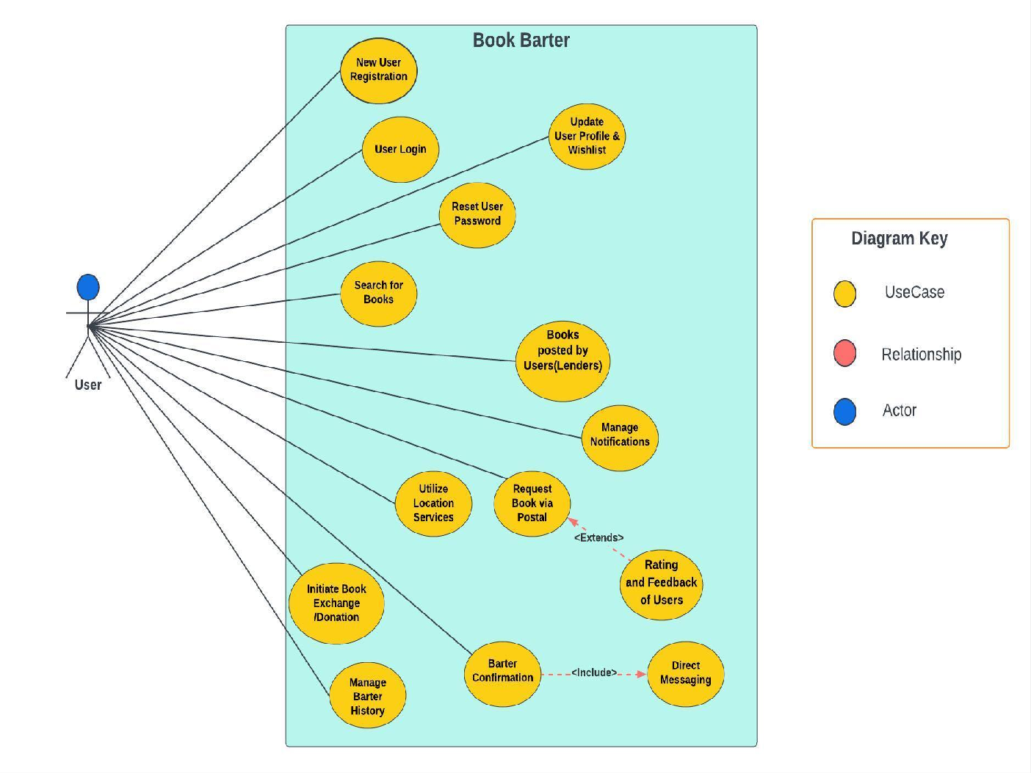

Slide 14
RUCTM

Slide 15
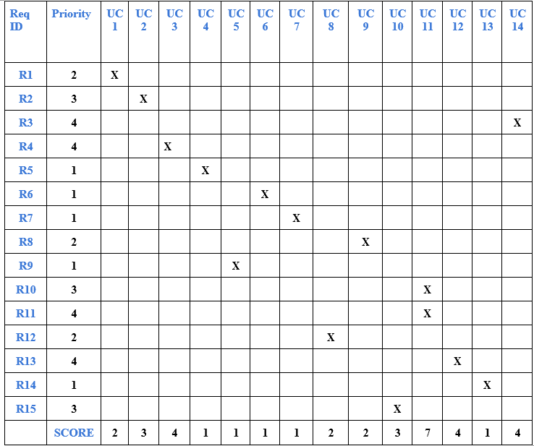

Slide 16
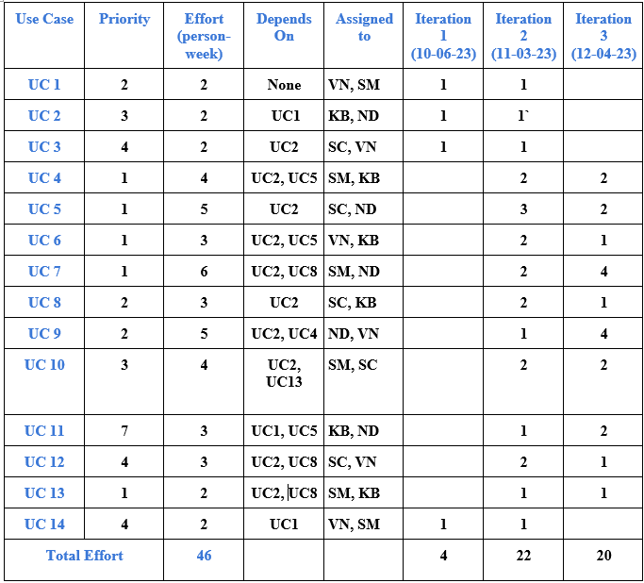
Increment Matrix
Team Members:
VN- Varad Nair
KB- Kushwanth Sai Bollepalli
SC- Srujan Chinta
ND- Niharika Dandu
SM- Sreelakshmi Mopuri
1 Person-Week = 5 hrs.

Slide 17
Domain Model

Slide 18
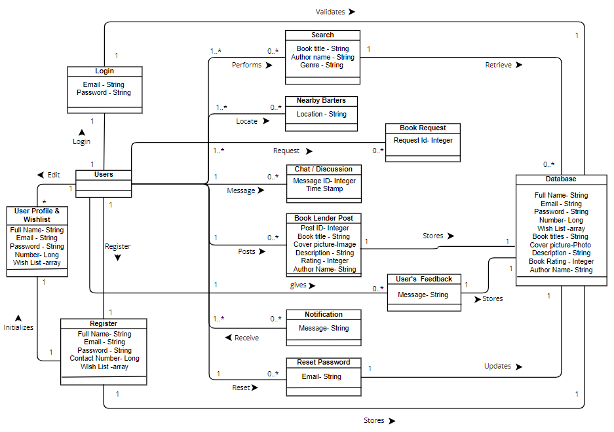

Slide 19
Summary
Effortless Book Discovery
Wishlist Management
In-Person/Local Book Exchanges
Seamless Communication
Postal Service Option Integration

Slide 20

THANK YOU

